Slide 1
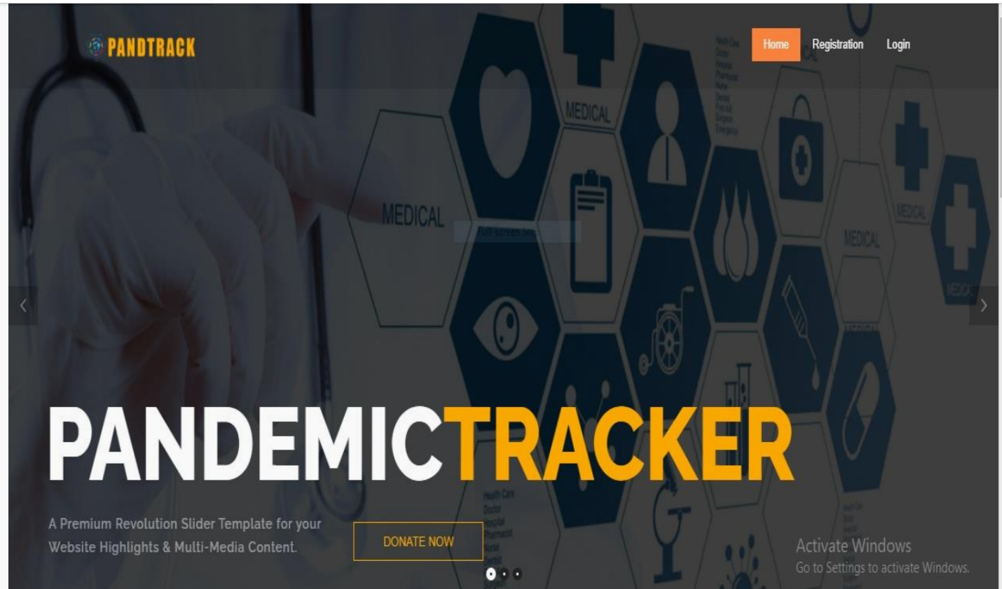
Name: AthulKrishna G Matriculation ID : 42311523
Github repo: https://github.com/AthulKrishnaG/Pand-Track.git

Slide 2
Introduction
PANDTRACKER – PANDEMIC TRACKING SYSTEM (PST)
It is used to track the details of the pandemic patients whole over the Kerala.
System is mainly used by medical officers in health department to access the pandemic patients details and also includes their symptoms.
The software has the facility to give a unique ID for every patient and stores the details of every contact listed persons.
The pandemic areas are separated into different hot-spots.
The software updates the number of pandemic patients and spot areas.
Users can search daily updates
Notes:
The app saves information directly in a data.json document which makes the use of complicated databases unnecessary. The goal is to help people develop better money habits by creating an easy-to-use system that works everywhere they need it.

Slide 3
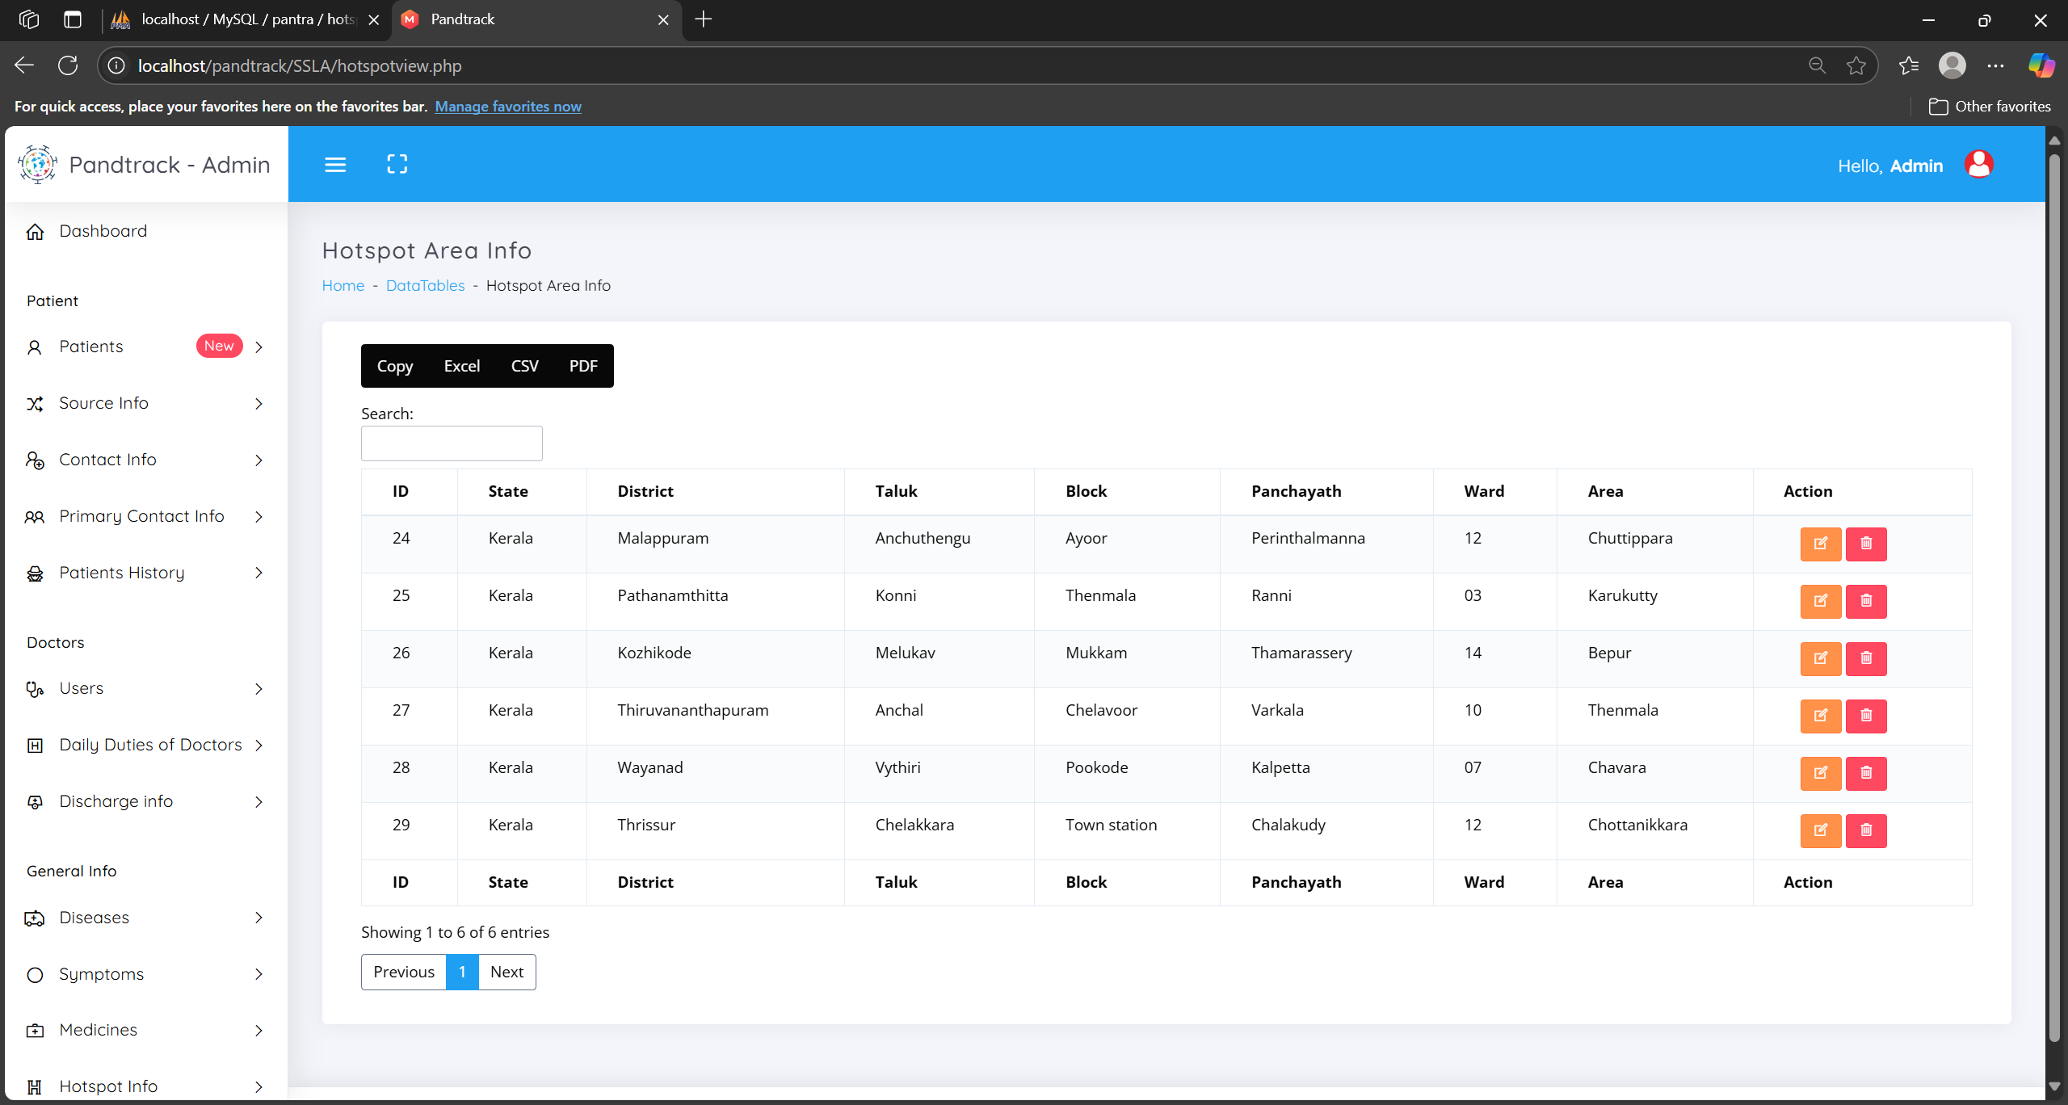
Purpose of the Web Application
PANDTRACK will simplify and generalize the activities of health care system.
Provides list of Medical officers, doctors, patients, hot spot areas.
Notes:
The app solves the everyday problem of keeping personal financial records orderly. Our interface design helps users check their money movements easily to make better financial choices. This web platform focuses primarily on user-friendly design.

Slide 4
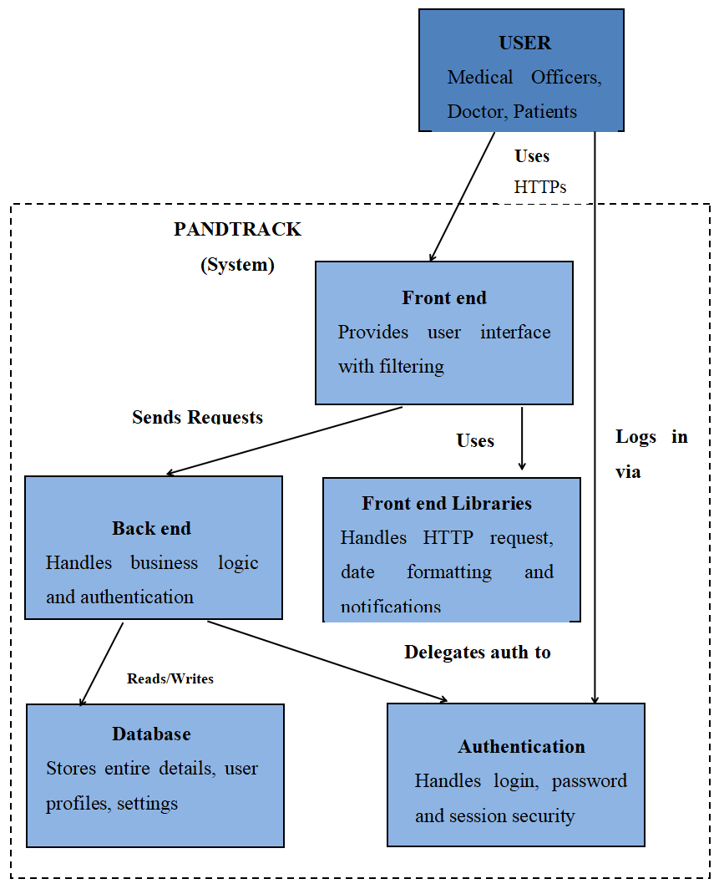
High-Level Architecture Diagram
Notes:
User actions on the front-end send requests that reach the back-end. Data requests go through the back-end to modify or retrieve data from data.json in order to function properly.

Slide 5
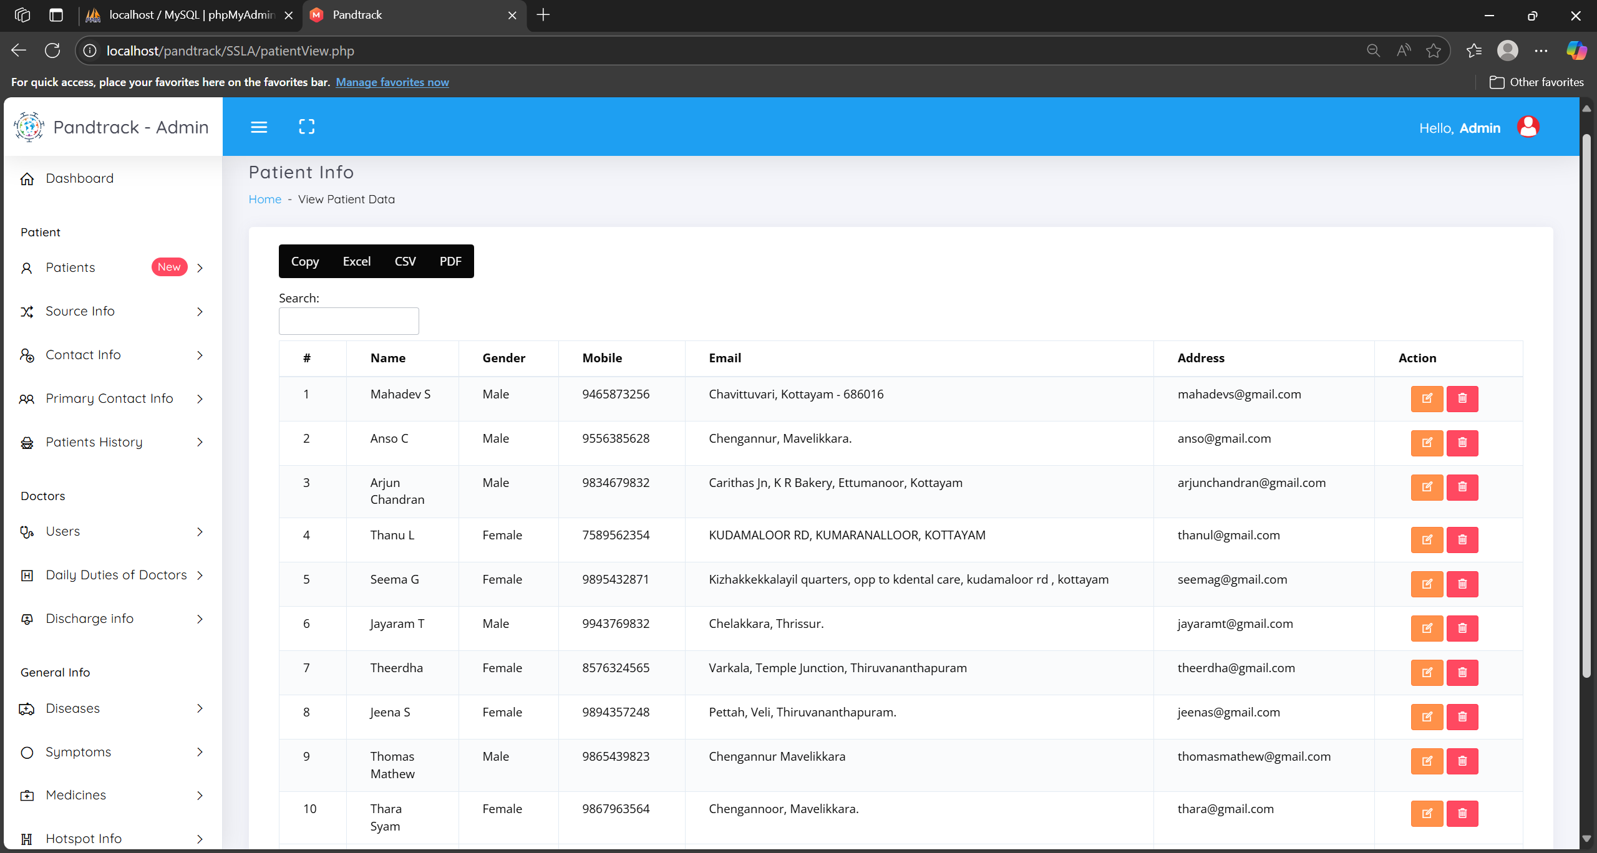
Frontend Technology
The HTML and CSS layout of the PANDTRACKER provides ease of use and is efficient.
HTML gives the app a proper structure that makes all elements easy to find.
CSS styles and adjusts page displays to make websites look good and work well on all screens from phones to large desktops.
Bootstrap the front-end framework contains CSS and HTML based design templates for typography, forms, buttons, tables, navigation, modals, image carousels and lots of JavaScript plugins.
Notes:
The application uses CSS animations to create interest and style while keeping its design simple and easy to navigate. These tools due to their compact size which speeds up page loading and reduces the burden for future updates. The strategy directly achieves the website's target of providing simple access to features with maximum usability.

Slide 6
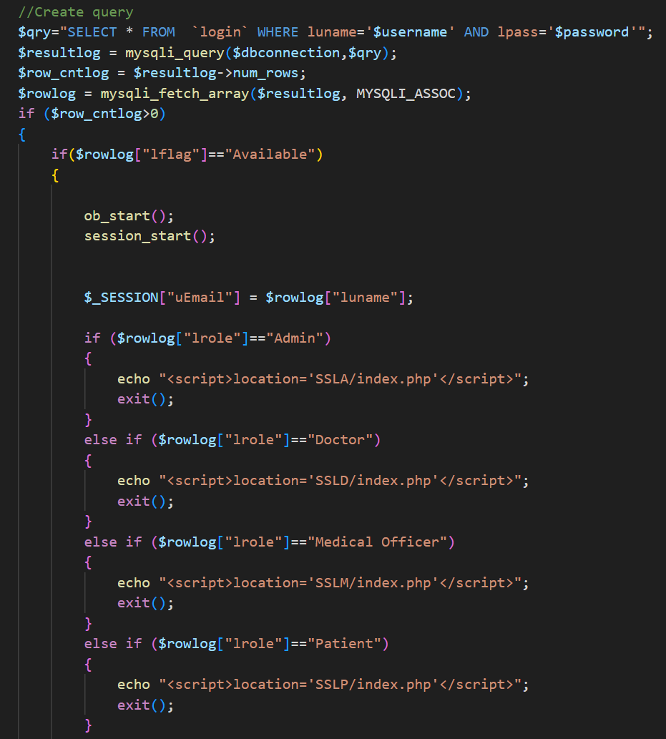
Backend Technology
MySQL Database Server is extremely fast, reliable and easy to use.
Notes:
Using the lightweight data.json file to store data effectively while keeping transaction processes fast without requiring a full database system. The system design simplifies operations and reduces costs while making future developments easier to implement.

Slide 7
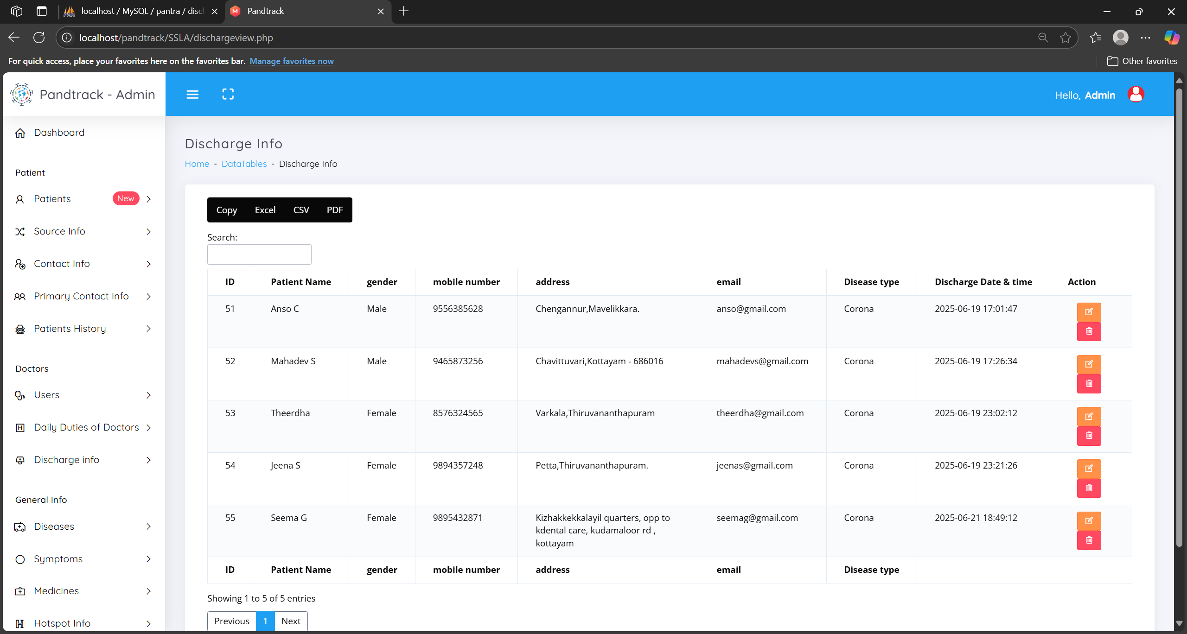
Features of the Application
Online registration for pandemic diseases.
Consultation history.
Pandemic areas are divided into hot-spots.
Find contact listed persons.
Symptoms, diagnosis and Medicine history.
Reports of pandemic diseases.
Schedule of duty to Doctor’s.
Notes:
Present the core operational components that support both application efficiency and user experience. Demonstrate how users can enter transactions without effort and view structured financial logs to learn about their money behavior. Create a platform that adjusts itself to work well on any device users choose.

Slide 8
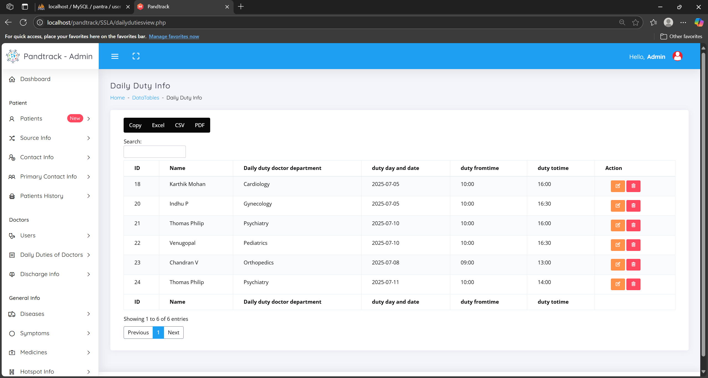
Screenshots
Login Page: Simple user authentication, User-friendly entry point.
Dashboard: Admin :displays Doctor Type, Hotspot Area and Contact List .
Responsiveness: Adapts layout across devices (mobile, tablet, desktop).
Notes:
Demonstrate the essential features of the application's main pages. The Login Page supports basic verification of users attempting access. The Dashboard shows users their budget situation through visible data about what they earn, where they spend money, and their current financial status. Users can easily input or adjust their transactions through the Form interface. This app adapts seamlessly to desktops, tablets or mobile devices keeping every feature accessible to users.

Slide 9
Changes from Phase 1 Proposal
Added: Proper validation and authentication done. Improved responsiveness for the screens.
Modified: Simplified transaction forms for ease of use.
Notes:
The adaptation of this project design since we submitted the first plan. The development team implemented an authentication login option for users to verify their trust in financial tracking. We adapted transaction forms to make them easier for users to interact with. it shifted the focus to improve how the app looks and works on all devices.

Slide 10
TEST CASES
Test Case 1 : Add Patients
Objective : Ensure a user to add the details of a new patient.
Steps:
Login as Admin
Navigate to “ Patients” -> “Add Patients”
Fill in Patient Name, Gender, E-mail, Contact number and Address
Click “Save”
Expected Result: Patient details are stored and visible in the View tab
Pass Criteria:Patient details are stored and saved to MySQL and displayed.
Test Case 2 : Add Source information of Patients
Objective : Ensure a user to add the source info of a patient.
Steps:
1.Login as Admin
2.Navigate to “ Source Info” -> “Add Source”
3.Select a Patient, fill in Confirmed Location, State, District, Panchayath and Ward of the selected patient.
4.Click “Save”
Expected Result: Source information of the Patient are stored and visible in the View tab
Pass Criteria:Source information of the Patient are stored and saved to MySQL and displayed.
Test Case 3 : Add patients history information
Objective : Ensure a user to add the history info of a patient
Steps:
Login as Admin
Navigate to “ Patients History” -> “Add History”
Select a Patient, fill in Days after Onset of Disease, Effective Medicines
Click “Save”
Expected Result: Medicine history of the Patient are stored and visible in the View tab
Pass Criteria:Medicine history of the Patient are stored saved to MySQL and displayed.
Notes:
The testing confirmed that basic app functions operated correctly by reviewing the ability to enter and remove transactions which showed proper historical and summary reporting. The testing confirmed that the app can run smoothly on screens of all sizes from phones to tablets to desktops. All test procedures performed successfully without revealing substantial technical difficulties.

Slide 11
